Slide 1




Slide 2

PROBABILITY

Slide 3
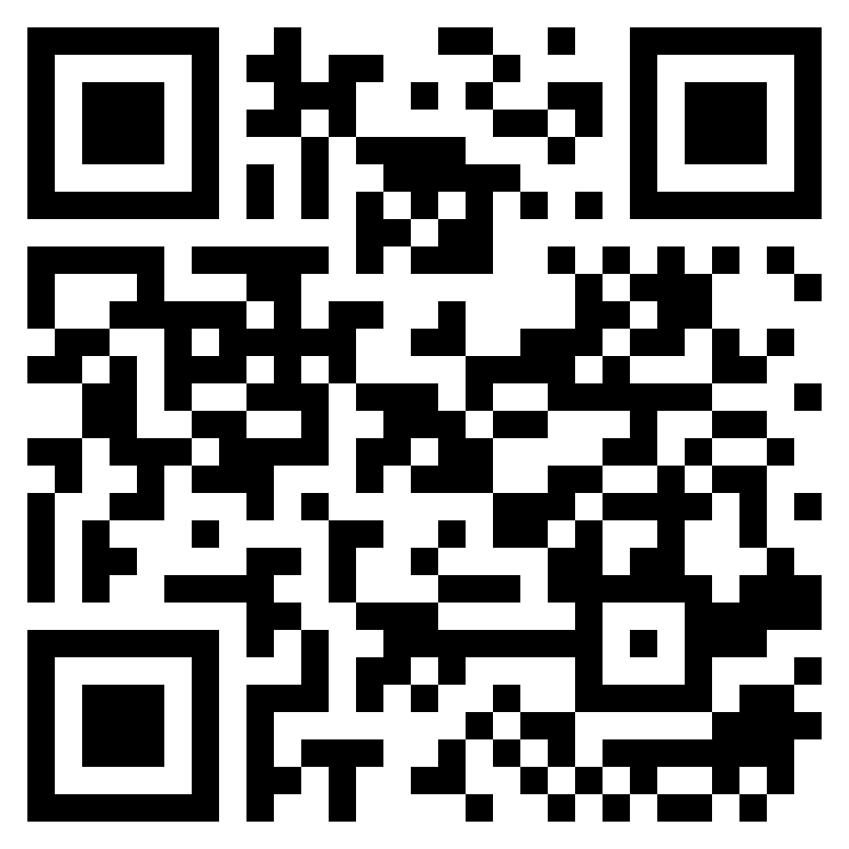
TEST TIME ON PERMUTATION AND COMBINATIONS-2
URL:https://forms.gle/8oH677T3KsfXi24x5
QR CODE:

Slide 4
DIFFERENT WAYS TO CREATE AN OBJECT
PROBABILITY
1. Probability Range = 0 = P(A) = 1 2. Rule of Complementary Events = P(AC) + P(A) = 1 3. Rule of Addition = (A or B) = P(A) + P(B) - P(AnB) 4. Disjoint Events Events A and B are disjoint iff = P(AnB) = 0 5. Conditional Probability = P(A | B) = P(AnB) / P(B) 6. Bayes Formula = P(A | B) = P(B | A) · P(A) / P(B) 7. Independent Events Events A and B are independent iff = P(AnB) = P(A) · P(B)

Slide 5
DIFFERENT WAYS TO CREATE AN OBJECT
TIPS TO SOLVE
PROBLEMS BASED ON COINS:
The Possible Number of Outcomes is always Calculated by 2∧n
When a Coin is Tossed then the Possible ways=2¹=2(Head or Tail)
When Three Coins are Tossed then the Possible ways=2³=8(HHH,HHT,HTH,HTT,THH,THT,TTH,TTT)
The Question from this Coin Pattern May have 3 words to trick you that is
ATMOST
ATLEAST
EXACTLY
Atmost 2 heads --------------🡪 Maximum of two heads
Atleast 2 heads -----🡪 Minimum of Two heads or May be more than 2 heads
Exactly 2 heads ----🡪 only 2 heads not more than that not less than that.

Slide 6
DIFFERENT WAYS TO CREATE AN OBJECT
TIPS TO SOLVE
PROBLEMS BASED ON DICE:
The same Logic Applies here that is the Possible number of Outcomes is 2 ^ n
When a Single Dice is thrown the number of Possibility=6¹=6(1,2,3,4,5,6)
When two Dice are thrown then the number of Possible Outcomes=6²=36
[(1,1)(1,2)(1,3)(1,4)(1,5)(1,6)
(2,1)(2,2)(2,3)(2,4)(2,5)(2,6)
(3,1)(3,2)(3,3)(3,4)(3,5)(3,6)
(4,1)(4,2)(4,3)(4,4)(4,5)(4,6)
(5,1)(5,2)(5,3)(5,4)(5,5)(5,6)
(6,1)(6,2)(6,3)(6,4)(6,5)(6,6)]
Mostly Question Will Be Based On The Below Format:
Sum Of The Number Should Be 6 Or 7 Or Any Value
Difference Of The Number Should Be 3[(1,4)(2,5)(3,6)]

Slide 7
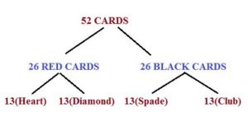
DIFFERENT WAYS TO CREATE AN OBJECT
TIPS TO SOLVE
PROBLEMS BASED ON CARDS:
In Card Based Problem Remember this Hierarchy
13 Cards in Each Category is:
Numbers (1 to 9) 9 cards
Ace-1,Jack-1 Queen-1 King-1 (4 cards)

Slide 8
DIFFERENT WAYS TO CREATE AN OBJECT
Question: 01
A pair of 8 sided dice has sides numbered 1 to 8.Each side has same probability or chance of landing face up.The probability that the product of 2 numbers on the sides that land face up exceeds 36 is
11/64
5/32
3/16
1/4
Answer: B
Notes:
Sol 1:
total possibble combination=8c1*8c1=8*8=64 total possible combinations that exceeds 36=(5,8),(6,7),(6,8),(7,6),(7,7),(7,8),(8,5),(8,6),(8,7),(8,8)=10 the probability=10/64=5/32
Sol:2
Only Possible results in the output buffer are:(5,8),(6,7),(6,8)....(8,8). therefore total number of desired output=11 total number of possible results are 8*8=64 therefore required ans=10/64=5/32

Slide 9
Explanation: 01
Sol 1:
total possibble combination=8c1*8c1=8*8=64 total possible combinations that exceeds 36=(5,8),(6,7),(6,8),(7,6),(7,7),(7,8),(8,5),(8,6),(8,7),(8,8)=10 the probability=10/64=5/32
Sol:2
Only Possible results in the output buffer are:(5,8),(6,7),(6,8)....(8,8). therefore total number of desired output=11 total number of possible results are 8*8=64 therefore required ans=10/64=5/32
Answer: B

Slide 10
Question: 02
For the FIFA world cup, Paul the octopus has been predicting the winner of each match with amazing success. It is rumored that in a match between 2 teams A and B, Paul picks A with the same probability as A's chances of winning. Let's assume such rumors to be true and that in a match between Ghana and Bolivia, Ghana the stronger team has a probability of 2/3 of winning the game. What is the probability that Paul will correctly pick the winner of the Ghana-Bolivia game?
5/9
1/9
2/3
1/3
Answer: A

Slide 11
Explanation: 02
SOL 1:
Here probability of Ghana = 2/3.
=>The octopus also should have same probability in selecting
Ghana as winner = 2/3.
So total probability of selecting the right team (winning team) by the octopus is (2/3)(2/3)=4/9.
If Ghana has 2/3 chances, Bolivia will have 1-2/3=1/3 chances(Assuming that a tie is not possible).
So octopus also has 1/3 chances of selecting Bolivia.
So total probability for Bolivia would be (1/3)(1/3)=1/9.
Any team can win the match.
So total probability is 4/9+1/9=5/9
Answer: A

Slide 12
Question: 03
There are 6 positive and 8 negative numbers. Four numbers are choosen at random and multiplied.the probability that the product is positive is:
500/1001
503/1001
303/1001
101/1001
505/1001
Answer: E

Slide 13
Explanation: 03
Sol 1:
for positive number 6c4/14c4 + (6c2*8c2)/14c4 + 8c4/14c4 =505/1001 case1: only 4 positive no. case2: 2 positive and 2 negative no. case3: 4 negative no.
Sol2:
all four positive number = 6c4/14c4 all four negative number = 8c4/14c4 two numbers are positive and two are negative hencs probaility = 6c2*8c2/14c4 hence required probability = 6c4+8c4+(6c2*8c2)/14c4 15+70+15*28/1001 505/1001
Answer: E

Slide 14
Question: 04
A question has 7 options. If he chooses correct answer he can get one mark. If he chooses wrong option he looses one mark. If he chooses randomly he gets zero marks. Any way he identifies 2 options and eliminates them. If he chooses randomly how many marks can he gain?
1/6
1/15
1/5
1/20
Answer: A

Slide 15
Explanation: 04
Sol 1:
probability to choose correct option=1/7 and associated marks is 1; probability to choose incorrect option=6/7 and associated marks is x(let); total marks={(1/7)*1}+{(6/7)*x}=0, i.e. x=-1/6; now 2 options are eliminated, so,now, {(1/5)*1}+{(4/5)*(-1/6)}=1/15; Ans= 1/15.
Sol 2:
probability to choose correct answer is 1/7 and he get 1 marks for right answer probability to choose wrong answer is 6/7 and he loose 1 marks for wrong answer.
Answer: A

Slide 16
Explanation: 04
Then (1/7)*1+(6/7)*-1=0 according to question which is invalid so the associated marks for wrong answer is not one it must be some unknown which can be find by the following Let the marks for wrong be X (1/7)*1+(6/7)*-X=0 according to question then x=-1/6
Answer: A

Slide 17
Explanation: 04
After that he eliminated 2 incorrect options So probability to choose correct answer is 1/5 and wrong answer is 4/5 So his score={(1/5)*1}+{(4/5)*(-1/6)} =(1/5)+(-2/15) =1/15 then x=-1/6
Answer: A
Notes:
Sol 1:
probability to choose correct option=1/7 and associated marks is 1; probability to choose incorrect option=6/7 and associated marks is x(let); total marks={(1/7)*1}+{(6/7)*x}=0, i.e. x=-1/6; now 2 options are eliminated, so,now, {(1/5)*1}+{(4/5)*(-1/6)}=1/15; Ans= 1/15.
Sol 2:
probability to choose correct answer is 1/7 and he get 1 marks for right answer probability to choose wrong answer is 6/7 and he loose 1 marks for wrong answer. Then (1/7)*1+(6/7)*-1=0 according to question which is invalid so the associated marks for wrong answer is not one it must be some unknown which can be find by the following Let the marks for wrong be X (1/7)*1+(6/7)*-X=0 according to question then x=-1/6 After that he eliminated 2 incorrect options So probability to choose correct answer is 1/5 and wrong answer is 4/5 So his score={(1/5)*1}+{(4/5)*(-1/6)} =(1/5)+(-2/15) =1/15 then x=-1/6

Slide 18
Question: 05
Among a group of 2,500 people, 35 percent invest in municipal bonds, 18 percent invest in oil stocks, and 7 percent invest in both municipal bonds and oil stocks. If 1 person is to be randomly selected from the 2,500 people, what is the probability that the person selected will be one who invests in municipal bonds but NOT in oil stocks?
4/25
3/25
7/25
9/25
Answer: C

Slide 19
Explanation: 05
SOL 1:
Since there are 2,500 people, 2,500 (0.35) = 875 people invest in municipal bonds, and 2,500 (0.07) = 175 of those people invest in both municipal bonds and oil stocks.
Therefore, there are 875 - 175 = 700 people who invest in municipal bonds but not in oil stocks.
Probability of an event = number of desired outcomes/Total number of outcomes that can occur
Probability of investing in municipal bonds but not in oil stocks =700/2500=7/25
final answer =7/25​
SOL 2:
total no.of people = 2500 municipal bonds = 2500*35/100 = 875 oil stocks = 2500*18/100 = 450 municipal bonds and oil stocks(both) = 2500*7/100 = 175
Answer: C

Slide 20
Explanation: 05
We need only person who invests in municipal bonds i.e., municipal bonds - both(X) = 875-175 = 700 The probability is = X/total = 700/2500 = 7/25
Answer: C

Slide 21
Question: 06
3 cars A, B & C are in the race. A is twice as likely to win as B and B is thrice as likely to win as C. what is probability that B will win, if only one can win the race ?
1/2
2/5
3/10
1/10
Answer: C

Slide 22
Explanation: 06
3 cars A, B & C are in the race. A is twice as likely to win as B and B is thrice as likely to win as C. what is probability that B will win, if only one canSOL1:
let B's ability is x A is twice as likely to win as B,so A's ability is 2x C's ability is x/3 A :B: C --> A :B :C 2x:x :x/3 --> 4x:3x :x so probability that B will win is 3x/(4x+3x+x)=3x/10x=3/10
Answer: C

Slide 23

Question: 07
Eric throws 2 dice,and his score is the sum of the values shown.Sandra throws one dice and her score is the square of the value shown. what is the probability that Sandras score will be strictly higher than Erics score??
137/216
211/216
189/216
172/216
Answer: A

Slide 24
Explanation: 07
SOL 1:
sandra score can be like 1,4,9,16,25,36 eric score less then 1-->0 eric score less then 4=(1,1),(1,2)(2,1)-->3 eric score less then 9 are (1,1)(1,2)(1,3)(1,4)(1,5)(1,6)(2,1)(2,2)(2,3)(2,4)(2,5)(2,6)(3,1)(3,2)(3,3)(3,4)(3,5)(4,1)(4,2)(4,3)(4,4)(5,1)(5,2)(5,3)(6,1)(6,2)-->26 eric score will always be less then 16--->36 eric score will always be less then 25--->36 eric score will always be less then 36--->36 total favorable outcomes=3+26+36+36+36=137 total possible outcomes=216(36*6) probability=137/216
Answer: A

Slide 25
Explanation: 07
SOL 2:
Required probability= favourable outcomes/total outcomes = (3+26+36+36+36)/(216) = 137/216
Answer: A

Slide 26

Question: 08
A bag contains 1100 tickets numbered 1, 2, 3, ... 1100. If a ticket is drawn out of it at random, what is the probability that the ticket drawn has the digit 2 appearing on it?
A. 291/1100 B. 292/1100 C. 290/1100 D. 301/1100
Answer: C

Slide 27
Explanation: 08
SOL 1:
There are 19 times 2's appearing in (1 to 100, 301 to 400, 401 to 500, 501 to 600, 601 to 700, 701 to 800, 801 to 900, 901 to 1000 and 1001 to 1100 ) so there are 9*19= 171 times there are 20 times 2's appearing from 101 to 200 and 99 times 2's appearing from 201 to 300 therefore there are 171+20+99 = 290
SOL:2::
Numbers which dont have 2 from 1 to 9 = 8 Numbers which dont have 2 from 10 to 99: Let us take two places _ _. Now left most place is fixed in 8 ways. Units place is filled with 9 ways. Total 72 numbers
Answer: C

Slide 28
Explanation: 08
Numbers which dont have 2 from 100 to 999 =_ _ _ = 8 × 9 × 9 = 648 Numbers which dont have 2 from 1000 to 1099 =10_ _ = 9 × 9 = 81 Finally 1100 does not have 2. So 1. Total number with no 2 in them = 8 + 72 + 648 + 81 + 1= 810 Tickets with 2 in them = 1100 - 810 = 290 Required probability = 290 / 1100 ====290/1100
Answer: C

Slide 29
Question: 09
Thirty days are in September, April, June and November. Some months are of thirty one days. A month is chosen at random. Then its probability of having exactly three days less than maximum of 31 is
A. 15/16
B.1
C.3/48
D.None of these
Answer: C

Slide 30
Explanation: 09
SOL 1:
Prob(Getting Feb month of 28 days) = Prob(selecting non leap year) X Prob(Selecting feb month after non leap year has chosen) Prob(Getting Feb month of 28 days) = (3/4) x (1/12) = 3/48
Answer: C

Slide 31
DIFFERENT WAYS TO CREATE AN OBJECT
Question: 10
Two friends decided to meet at some time 3 p.m. 4 p.m. on a certain day at a gym. They didn't fix the exact time but they agreed that the one who arrived first at the gym that would wait up to 20 minutes (but no more)for the other person. Assuming that each of them went to the gym at some time between 3 p.m. and 4 p.m, find the probability that they-did not meet that day.
1/3
2/3
5/9
4/9
Answer: D

Slide 32
DIFFERENT WAYS TO CREATE AN OBJECT
Explanation: 10
from 3pm to 4pm we can divide 20 mints as 3 to 3.20 and 3.20 to 3.40 and 3.40 to 4 pm so we have 3 possibilities so individual prabability they dont meet is 2/3 total probability is 2/3*2/3=4/9
Answer: D

Slide 33
DIFFERENT WAYS TO CREATE AN OBJECT
Question: 11
Seven speakers A1, A2, A3,...., A7 were scheduled to speak at a function. In how many ways their speech can be arranged, such that: A1 speaks before A3 , and A3 speaks before A5 .
840
860
420
410
Answer: A

Slide 34
DIFFERENT WAYS TO CREATE AN OBJECT
Explanation: 11
Sol 1:
3 people can be selected from 7 in 7c3 ways arranging those 3 people is only in one way. remaining 4 can be arranged in 4! ways. so 7c3*1*4!=840 short cut: 7!/3!
Answer: A

Slide 35
DIFFERENT WAYS TO CREATE AN OBJECT
Question: 12
A father purchased dress for his 3 daughters. The dresses are of same color but diff size and they are kept in dark room. what is probability that all the 3 will not choose there own dress?
2/3
1/3
4/3
7/3
Answer: B

Slide 36
DIFFERENT WAYS TO CREATE AN OBJECT
Explanation: 12
Method 1) 3 daughters (correct pairs daughter no. 1-a 2-b 3-c) probability that daughter 1 will choose correct dress (i.e a) is 1/3 probability that daughter 1 will not choose a is 1- 1/3 = 2/3. remaining dresses 2 out of which only 1 pair is correct (as first daughter picked someone else's dress) so if either 2 or 3 pick incorrect dress with probability of 1/2 last pair is guaranteed wrong total probability = 2/3 * 1/2 * 1 = 1/3
Answer: B

Slide 37
DIFFERENT WAYS TO CREATE AN OBJECT
Explanation: 12
method 2) let A`s dress named A, B dress named B, C`s dress named C. Then,Total Combinations are 3!=6 A B C A C B C B A B A C B C A C A B Now, We have to find a condition where A does not choose her dress, B does not choose her dress and C does not choose her dress.
Answer: B

Slide 38
DIFFERENT WAYS TO CREATE AN OBJECT
Explanation: 12
In first four condition, either A or B or C choose either of its right choice like in ACB, A choose right choice... and so on but in last two cond. B C A C A B None of them chooses right choice So fav outcome=2 and total outcome=3!=6 prob-2/6=1/3
Answer: B

Slide 39
DIFFERENT WAYS TO CREATE AN OBJECT
Question: 13
How many two-digit numbers are there which, when subtracted from the number formed by reversing its digits as well as when added to the number formed by reversing its digits, result in a perfect square?
1
2
3
4
Answer: A

Slide 40
DIFFERENT WAYS TO CREATE AN OBJECT
Explanation: 13
Sol 1:
10x+y be the 2 digit number then 10x+y+10Y+x(reverse) == 11(x+y) and 10x+y - (10y+x)== 9(x-y) solving x and y trail error method.. only one satisfies both the equations 6 and 5 ans: 1
SOL 2:
Let the number xy = 10x + y Given that, 10x+y - (10y - x) = 9(x-y) is a perfect square So x-y can be 1, 4, 9. -------- (1) So given that 10x+y +(10y +x) = 11(x+y) is a perfect square. So x+y be 11. options are (9,2), (8,3),(7,4),(6,5) hence only ( 6,5 ) satisfy the condition. .therefore ans. Is 1
Answer: A

Slide 41
DERENT WAYS TO CREATE AN OBJECT
Question: 14
A necklace is made by stringing N individual beads together in the repeating pattern red bead, green bead, white bead, blue bead and yellow bead. If the necklace begins with a red bead and ends with a white bead, then N could be:
A.16
B.32
C.54
D.68
Answer: D

Slide 42
DERENT WAYS TO CREATE AN OBJECT
Explanation: 14
Sol 1:
R G W B Y is the bead pattern and it repeats. Bead want to end with White. So, the 3rd, 8th, 13th, 18th... beads will be W. So, number of beads - 3 has to be divisible by 5 for it to be a White bead. For those conditions, option D(68) only satisfy. i.e., 68 - 3 = 65 and that also divisible by 5. S0, 68 is the answer.
Answer: D

Slide 43
DIFFERENT WAYS TO CREATE AN OBJECT
Question: 15
There are 14 spots. Each spot has 8 seats. 28 people seated in all spots. No similar number of people sat in any spot. How many spot left with no people at all.
7
10
8
12
Answer: A

Slide 44
DIFFERENT WAYS TO CREATE AN OBJECT
Explanation: 15
SOL 1 :
Total 14 spots with 8 chairs at each spot different number of people so, possible combinations 1+2+3+4+5+6+7+8 but, only 28 people their so, 1+2+3+4+5+6+7=28 so 7 possibilities vacant=14-7=7
Answer: A

Slide 45
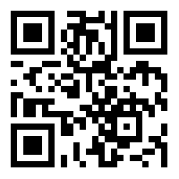
https://learn.codemithra.com

Slide 46




THANK YOU
+91 78150 95095
codemithra@ethnus.com
www.codemithra.com

